Slide 1
Fundamentals of Heat Transfer

Slide 2
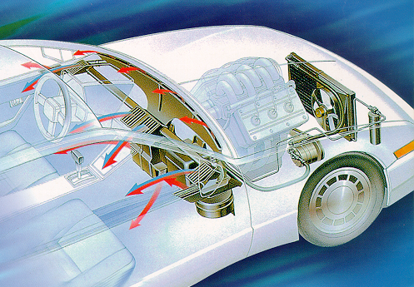
Heat Transfer
Mobile heating, ventilation, and air conditioning, MVAC systems are concerned with moving heat to or from the interior of a vehicle. Heat transfer involves moving something that we can feel but cannot see.
Understanding the principles of heat transfer helps a technician understand what happens within an A/C system.

Slide 3
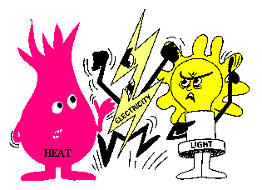
Heat Is Energy
Heat, like other forms of energy, cannot be created nor destroyed. However, we have the ability to move it from one place to another.

Slide 4
Heat Measurements
Temperature
Quantity

Slide 5
Heat Measurements - Temperature
Temperature is a measurement of heat intensity
Measured using a thermometer
Two commonly used scales:
Fahrenheit
Celsius

Slide 6
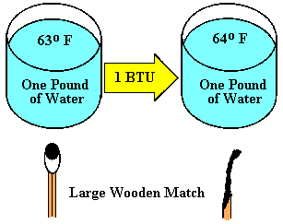
Heat Measurements - Quantity
Heat quantity is also measured using two scales: Calories (c) by most of the World and British Thermal Units (BTU) in the United States.
One BTU will increase the temperature of one pound of water by one degree F.
One c will increase the temperature of one g of water by one degree C.
Burning a large wooden match produces about 1 BTU of heat.

Slide 7
Intensity and Quantity
A MHVAC technician is concerned with heat intensity when he or she is testing or repairing a HVAC system to make sure it is operating correctly.
A vehicle design engineer is concerned with heat quantity while designing a system to make sure it is the correct size to provide adequate heat transfer. It must move enough heat to keep the interior of a vehicle warm in cold climates and cool in very hot areas.

Slide 8
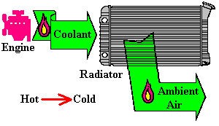
Heat Movement
Heat always travels from Hot to Cold.
In this example, heat within the engine will move from the very hot combustion chamber to the (cooler) coolant. After the coolant is moved to the radiator, the heat will move to the (cooler) air passing through it.

Slide 9
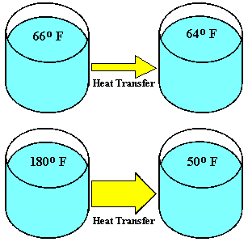
Heat Transfer Rate
Heat transfer rate is determined by the temperature difference between the hot and cold items. A minor difference (top) will have a slow rate. A large difference will cause a much faster rate of heat exchange.

Slide 10

Heat Conduction
Heat transfer through a material, from one molecule to the next is called conduction. The heat entering this metal rod is flowing to the ends.

Slide 11

Convection
When we move heat by circulating a medium like air or water, we call the process: convection. The coolant circulating in the cooling system transfers heat from the engine to the radiator and the warm or cool air circulating through the vehicle are both examples of convection.
Notes:
Convection is the process of transferring heat by moving the heated fluid, in either a liquid or gaseous state. So we can heat it in one location and move it to another location where the heat is released. An example is a cooling system or an a/c system on a vehicle.

Slide 12
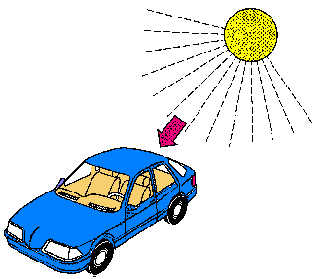
Radiation
The heat transfer from the Sun to the Earth is an example of radiation. Heat is transferred, but it does not warm the medium (space) through which it passes. Radiant heat will warm the interior and exterior of a vehicle that is parked in the sun.
Notes:
Radiation is the process of heat passing from one location to another without warming the area through which it passed. An example is the sun heating dark objects on earth while passing through cold air space, or through glass to a dark object.

Slide 13
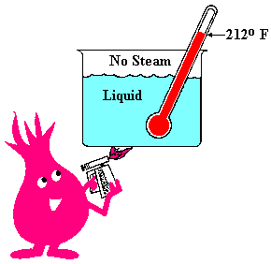
Adding Heat
When we add heat, we will warm up the liquid, in this case it is water. We are converting the energy in the fuel to fire and transferring this heat to the water.
We would have to remove heat if we wanted to cool the water.

Slide 14
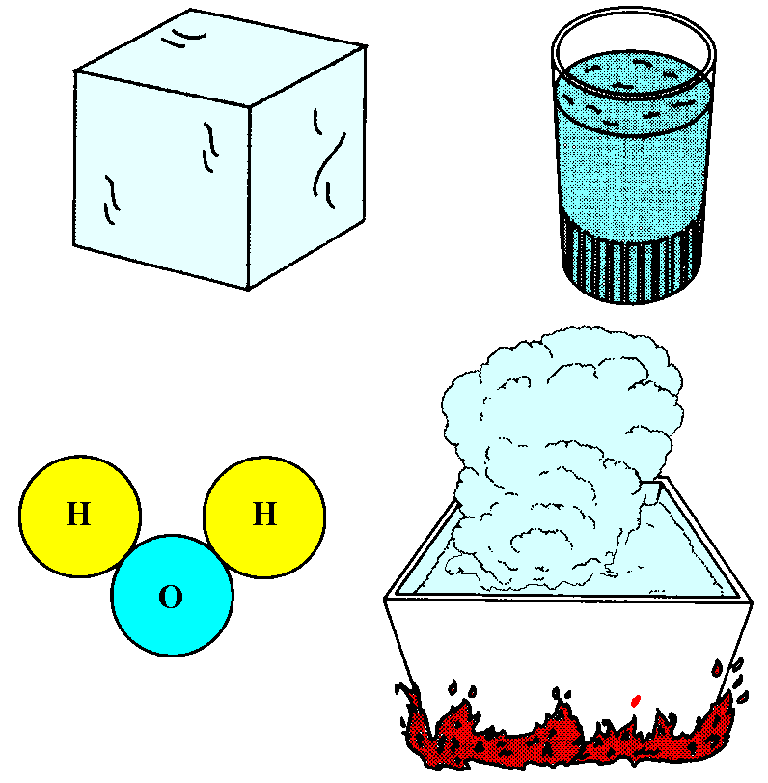
States of Matter
Water is a molecule formed from two hydrogen atoms and one oxygen atom. So is ice and steam. Ice is normally a solid at cold temperatures, and steam is the high temperature, gas form of water.
They are all the same molecule, but they have a tighter or looser molecular bond between the atoms. It takes energy to change this bond.
Solid: Ice Below 32 F Liquid: Water
Gas: Steam, Above 212 F

Slide 15
Sensible and Latent Heat
If we add heat to water, the temperature will increase, and this is called sensible heat. Sensible heat causes a change in temperature.
If we add heat to ice at 32º F or to water at 212º F, the temperature will not increase. The added heat will melt some of the ice or boil some of the water. This is called latent heat. Latent heat causes a change in state but not a change in temperature. This heat energy changes the molecular bond within the molecule.

Slide 16
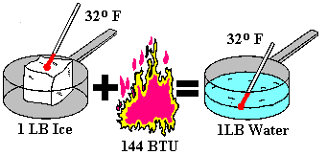
Latent Heat of Fusion
144 BTUs are required to melt one pound of ice. There will be no temperature increase, just a change of state from ice to water. Although this change of state in not used in vehicle temperature control, it is used to cool ice chests..

Slide 17
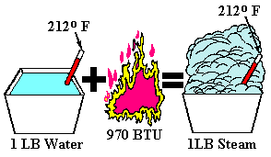
Latent Heat of Evaporation & Condensation
A rather large amount of heat, 970 BTUs, is required to change one pound of water into one pound of steam with no temperature increase. This change of state is used as the refrigerant boils when it enters the evaporator and condenses when it passes through the vehicle’s condenser.

Slide 18
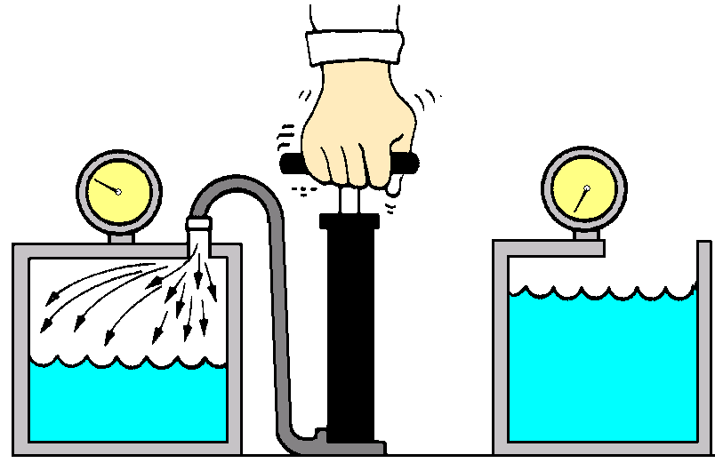
Boiling Points and Pressure
Boiling Point = 242 Degrees F
Boiling Point = 212 Degrees F
The boiling point will increase if we raise the pressure on a liquid. In this case, the boiling point will increase about 3º F for each psi. A 10 pound pressure will increase the boiling point about 3 X 10 or 30º F. The condensing point of a vapor is the same as the boiling point.

Slide 19
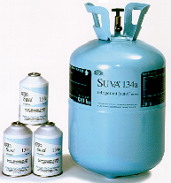
Refrigerant
R-134a has a boiling point of –15º F. When it is released into the vehicle’s evaporator it will boil immediately and absorb heat. R-134a will absorb almost 78 BTUs of heat for each pound that boils.

Slide 20
The End

